Slide 1
Object Oriented programming – Operator Overloading

Slide 2
Objects as Function Arguments and return data type
Objects are user defined datatypes of a sort.
Hence they can be passed as function arguments
On a side note, we use constructor like this
Constructor()
{ count = 0; }
But its not a preferred way. Its better to initialize the variables like this instead
Constructor() : count(0)
Where count is int data member in Constructor class.

Slide 3
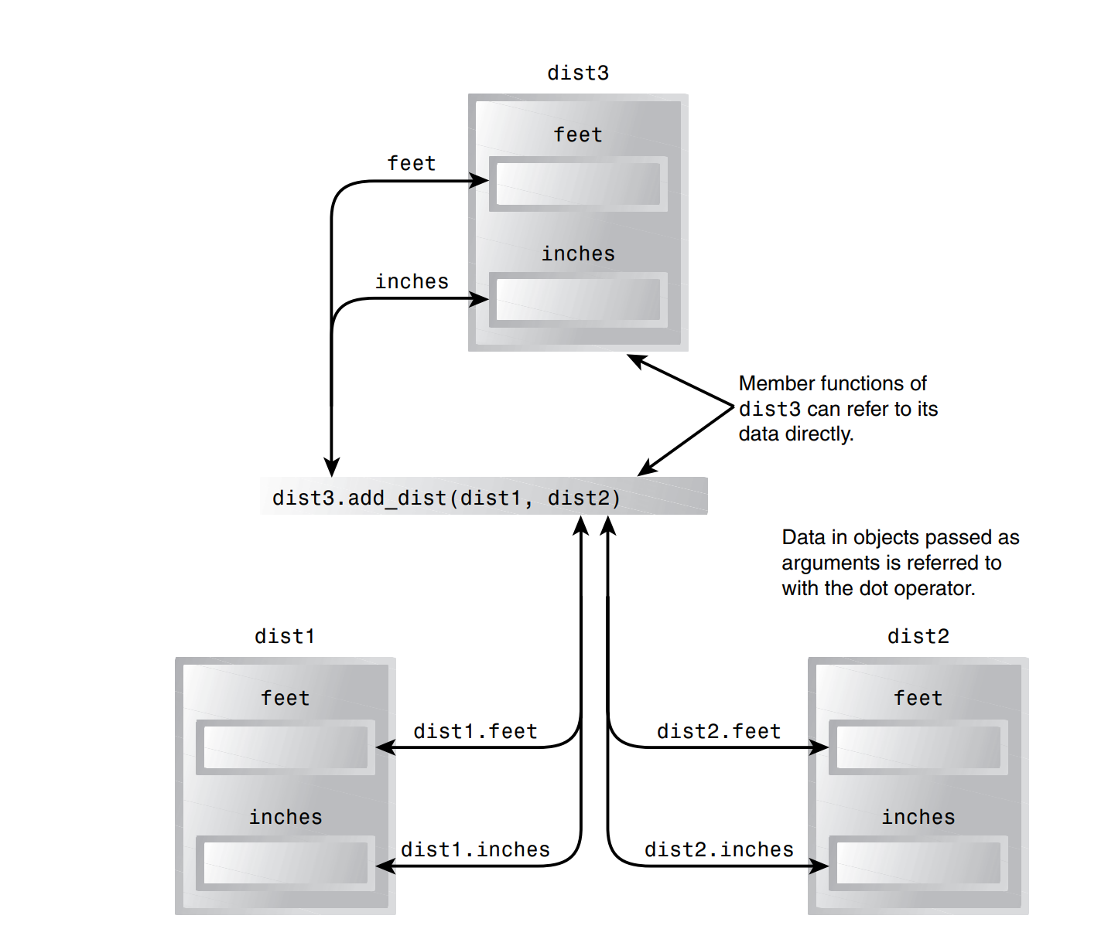

Slide 4
Overloading Unary Operators
Unary operators take only one argument
The operator Keyword
Used to teach a normal C++ operator to act on a user-defined operand.
Syntax: void operator ++ ()
Syntax order: Return type, keyword operator, operator (++), empty argument list.
Operator arguments
Unary operator overloading typically doesn't require any arguments in the function signature.
Since unary operators operate on the object itself, they can directly access the member variables or state of the object they are applied to.

Slide 5
Overloading Unary Operators (cont)
Operator Return values
The return type of the overloaded operator determines the behavior after the operator is applied.
For example, if the ++ operator is overloaded to return void, it implies that the operation modifies the object itself without returning any value.
Overloading allows custom behavior for objects, enabling operations tailored to their specific characteristics.
This customization can involve modifying the internal state of the object or even returning a new object with modified state, depending on the requirements of the application.

Slide 6
Overloading binary operators
Overloading binary operators in C++ allows custom behavior for operators like addition (+), subtraction (-), multiplication (*), etc., for objects of a class. Here's a brief overview:
Operator Keyword and Syntax:
Binary operators can be overloaded using the operator keyword followed by the specific binary operator being overloaded.
Syntax: return_type operator op (parameters), where op represents the binary operator being overloaded and parameters represent the arguments passed to the operator.

Slide 7
Overloading binary operators (cont’)
Operator Arguments:
Binary operator overloading typically takes one or two arguments, depending on the operator being overloaded.
For binary operators, one argument is often the object itself (this) and the other argument is the operand being used in the operation.
These arguments can be passed by value, reference, or const reference depending on the specific requirements of the operation.
Return Type and Overloading for an Object:
The return type of the overloaded operator determines the behavior after the operator is applied.
Overloading allows custom behavior for objects, enabling operations tailored to their specific characteristics.
This customization can involve modifying the internal state of the object, returning a new object with modified state, or performing any other operation relevant to the class.

Slide 8
guidelines for Operator Overloading
Use Similar Meanings
Use Similar Syntax
alpha += beta; should work the same as alpha = alpha + beta; where + is overloaded
Show Restraint
Avoid Ambiguity
Not All Operators Can Be Overloaded
member access or dot operator (.)
the scope resolution operator (::)
conditional operator (?:)
the pointer-to-member operator (->)
Also you cant create new operators s (like *&) and try to overload them

Slide 9
task
1. Operator overloading is a. making C++ operators work with objects. b. giving C++ operators more than they can handle. c. giving new meanings to existing C++ operators. d. making new C++ operators.
2. Assuming that class X does not use any overloaded operators, write a statement that subtracts an object of class X, x1, from another such object, x2, and places the result in x3.

